Slide 1

Analysis of Superstore Dataset

Slide 2
Project Title : Analysis of Superstore Dataset
Introduction :-
The "Analysis of Superstore Dataset" project aims to explore and analyze a comprehensive dataset from a fictional superstore. The management of Superstore, a retail company, wants to gain insights into their sales data to optimize their operations and improve profitability. They have provided a dataset containing information about their customers, products, and transactions over a certain period. The objective of this project is to analyze the dataset and extract meaningful insights by performing various data analytics techniques and statistical analyses. The analysis should focus on identifying patterns, trends, and relationships within the data, as well as identifying factors that may impact sales and customer behavior. Additionally, the project should include recommendations for the management team on potential strategies to increase sales, reduce costs, and enhance overall business performance based on the findings from the analysis.

Slide 3
Things I Did
Data Collection and Preprocessing: Collect and preprocess the Superstore dataset.
Sales Analysis: Analyze sales metrics, trends, and factors influencing sales fluctuations.
Customer Behavior Analysis: Study customer demographics, preferences, and segmentation for personalized strategies.
Exploratory Data Analysis (EDA) : Perform exploratory analysis, including data distribution, outliers, and visualizations.
Operational Efficiency Analysis: Evaluate operational efficiency, identify bottlenecks, and optimize resource allocation.
Conclusion and Next Steps: Summarize findings, plan for advanced analysis, predictive modeling, and integration of external data sources.

Slide 4
Agenda
Sr. No. | Topics Name
1. | Project Overview
2. | Modelling
3. | Data set Dataset loading About the Dataset
4. | Some Statistical Information
5. | Exploratory Data Analysis(EDA) Region Wise total Sales and Profit. Segment Wise total Sales and Profit. Category & Sub-Category Wise total Sales and Profit. City & State Wise total Sales and Profit.
6. | Results
7. | Conclusion

Slide 5
Project Overview
The Analysis of Sample Superstore Dataset project aims to leverage data analytics techniques to gain insights into the sales data of Sample Superstore, a retail company. The project involves analyzing a provided dataset containing information about customers, products, and transactions over a specific period.
The primary objectives of the project are as follows:
1. Data Exploration and Cleaning:
Explore the dataset to understand its structure and variables.
Identify and handle missing values, outliers, and inconsistencies.
Prepare the dataset for further analysis.
2. Descriptive Analytics:
Perform basic statistical analysis to summarize and describe the dataset.
Generate descriptive statistics, such as mean, median, mode, and standard deviation, for relevant variables.
Visualize data using charts, graphs, and histograms to gain initial insights.
3. Customer Segmentation:
Conduct customer segmentation based on various customer attributes, such as demographics and purchase behavior.
Apply clustering algorithms (e.g., K-means clustering) to identify distinct customer segments.

Slide 6
4. Sales Analysis:
Analyze sales trends over time (e.g., monthly, quarterly, yearly) to identify patterns and seasonality.
Examine the performance of different product categories and sub-categories.
Investigate the correlation between sales and other factors, such as region and customer segment.
5. Profitability Analysis:
Calculate profit margins for different products and product categories.
Identify the most profitable and least profitable products.
Analyze the impact of discounts, shipping costs, and other factors on profitability.
6. Customer Behavior Analysis:
Examine customer purchasing patterns, including frequency, recency, and monetary value.
Analyze customer loyalty and retention rates.
Investigate factors influencing customer churn and identify potential strategies for customer retention.
7. Recommendations and Insights:
Summarize the key findings and insights from the analysis.
Provide actionable recommendations to improve sales, profitability, and customer satisfaction.
Present the results in a clear and concise manner using visualizations and data-driven insights.

Slide 7
Who are the End Users
The end users of the Analysis of Sample Superstore Dataset project can include various stakeholders within the Superstore company. These stakeholders may include:
Management Team: The project's analysis and insights are primarily aimed at the management team of Sample Superstore. They are the key decision-makers who will utilize the findings to make strategic decisions and implement changes to improve the company's operations, sales, and profitability.
Business Analysts: Business analysts within Sample Superstore may use the project results to gain a deeper understanding of customer behavior, product performance, and sales trends. They can further analyze the insights and incorporate them into their reports and recommendations.
Marketing Team: The marketing team can benefit from the project's findings to develop targeted marketing strategies based on customer segmentation and preferences. The analysis can help them identify potential customer segments to focus on and tailor marketing campaigns accordingly.
Sales Team: The sales team can leverage the project's insights to optimize their sales approach. By understanding sales trends, product performance, and customer behavior, they can adapt their sales strategies to better meet customer demands and increase sales revenue.

Slide 8
Operations Team: The operations team can utilize the project's recommendations to streamline processes, improve inventory management, and optimize supply chain operations. They can identify areas of improvement based on the analysis of product categories, profitability, and customer satisfaction.
Finance Team: The finance team can benefit from the project's analysis of profitability and cost factors. The insights can help them identify cost-saving opportunities, evaluate the impact of discounts and shipping costs, and optimize pricing strategies.
Data Analysts/Scientists: Data analysts or data scientists within the organization can use the project as a reference for similar analyses and as a benchmark for future data-driven projects. They can also contribute their expertise in analyzing the dataset and extracting insights.

Slide 9
Solution and its Value Proposition
Solution: The solution for the "Analysis of Superstore dataset" project involves conducting a comprehensive analysis of the Superstore dataset to gain insights into sales trends, customer behavior, and operational efficiency. This analysis will be carried out using various statistical and data mining techniques, as well as advanced visualization tools.
Value Proposition: Our solution provides the following value propositions
Data-Driven Decision Making : By analyzing the Superstore dataset, we enable data-driven decision making for store managers and marketing managers. They can make informed decisions based on comprehensive analysis, leading to improved store performance, optimized operations, and targeted marketing strategies.
Enhanced Profitability : Our analysis helps identify opportunities for increasing sales, improving inventory management, and reducing costs, ultimately leading to enhanced profitability for the Superstore.
Customer Insights and Personalized Marketing : By analyzing customer behavior, demographics, and preferences, our solution provides valuable insights to marketing managers. This enables them to develop personalized marketing campaigns, tailor promotions, and enhance customer engagement, resulting in increased customer satisfaction, retention, and ultimately, higher sales.
Competitive Advantage : Leveraging the power of data analysis, our solution provides the Superstore with a competitive advantage in the market.
Cost Optimization: Our profitability analysis highlights the most and least profitable products and identifies factors impacting profitability. This empowers the management team to optimize pricing, manage discounts, and streamline operations for cost savings.

Slide 10
How did you Customize the Project and Make it your Own
Personalized Project Objectives: I would review the initial project objectives and consider any additional goals or specific areas of focus that align with my expertise or interests.
Tailored Analysis Techniques: While the project might include suggested analysis techniques, I would bring in my knowledge of advanced analytics methods or specialized statistical models that could provide deeper insights.
Creative Data Visualization: To present the analysis findings in a visually appealing and easily understandable manner, I might explore creative data visualization techniques beyond the typical charts and graphs. This could involve using interactive dashboards, storytelling techniques, or infographics to engage stakeholders and convey the insights effectively.
Domain-specific Insights: Drawing from my domain knowledge or prior experience, I would provide context-specific insights that go beyond the basic analysis
Real-world Implementation Strategies: While recommendations are a crucial part of the project, I would ensure they are practical and actionable. This could involve providing specific implementation strategies, such as launching loyalty programs, optimizing pricing structures, or improving inventory management.

Slide 11
Modelling techniques, Methodologies and Frameworks were applied
Exploratory Data Analysis (EDA) : EDA techniques were employed to gain initial insights into the dataset. This included data visualization through charts, graphs, and plots to understand the distribution of variables, identify outliers, and detect patterns or relationships between different variables.
Statistical Analysis : Utilized to uncover correlations, trends, and patterns within the Superstore dataset. These techniques helped in understanding the impact of various factors on sales, customer behavior, and operational efficiency.
Customer Segmentation : applied o categorize customers based on their attributes and buying behavior. This allowed for the identification of distinct customer groups with specific needs and preferences, enabling targeted marketing strategies.
Data Visualization : Advanced data visualization techniques using tools like Python libraries (e.g., Matplotlib, Seaborn) were used to create visually appealing and informative charts, graphs, and dashboards. These visualizations facilitated the effective communication of analysis results and provided a clear representation of key findings. These modelling techniques, methodologies, and frameworks formed the foundation of the "Analysis of Superstore dataset" project for Data Analytics, ensuring a systematic and data-driven approach to extract valuable insights from the dataset.

Slide 12
Dataset
1. Data Set URL :
https://www.kaggle.com/datasets/bravehart101/sample-supermarket-dataset
2. About the dataset :
The dataset provides information about the sales and profit from a supermarket.
3. Dataset details : the dataset contains the following format -
Size | 1.06 MB
Number of columns | 13
Number of rows | 9994
Original file format | CSV

Slide 13
Importing the dataset and Perform Operations
# Importing libraries
import pandas as pd
import numpy as np
# Loading Dataset
df=pd.read_csv("SampleSuperstore.csv")
# checking data type and missing values:
df.info()
# Read the columns or Features of the dataset:
df.columns
# Null Value check:
df.isnull().sum()
# Read the Duplicate value:
df.duplicated().sum()

Slide 14
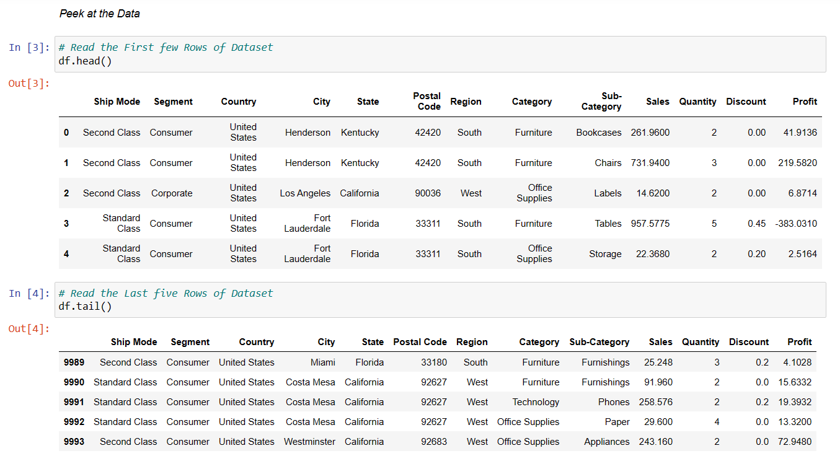
Pre-Processing of data & Exploratory data analysis

Slide 15
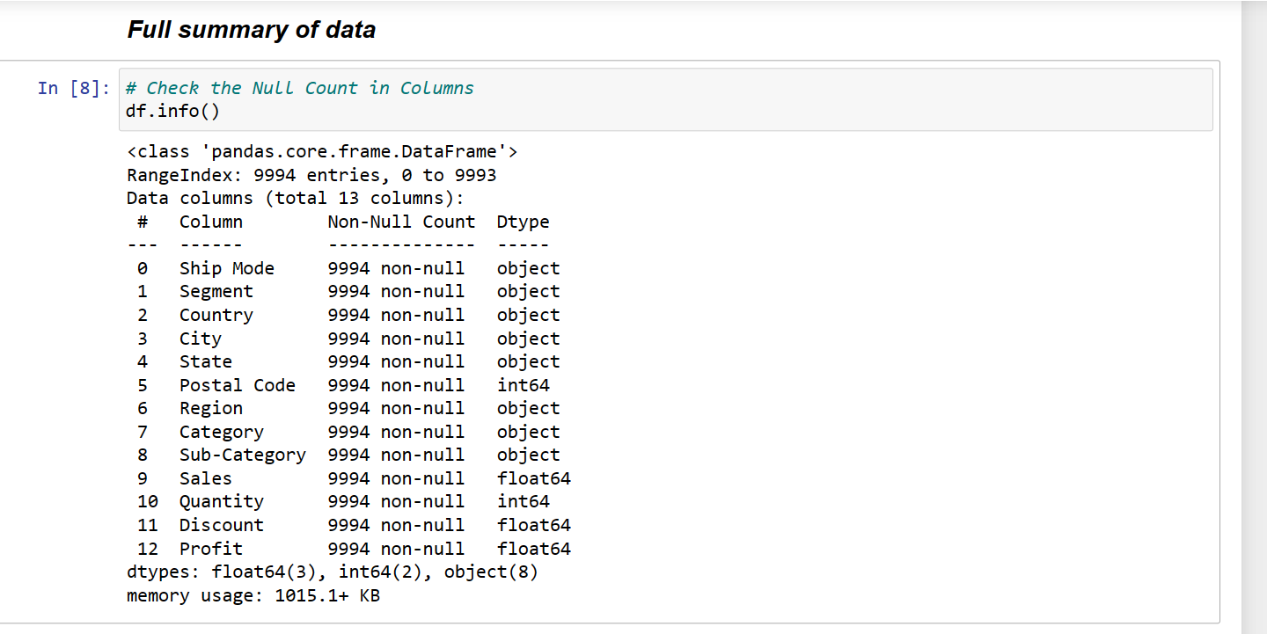

Slide 16
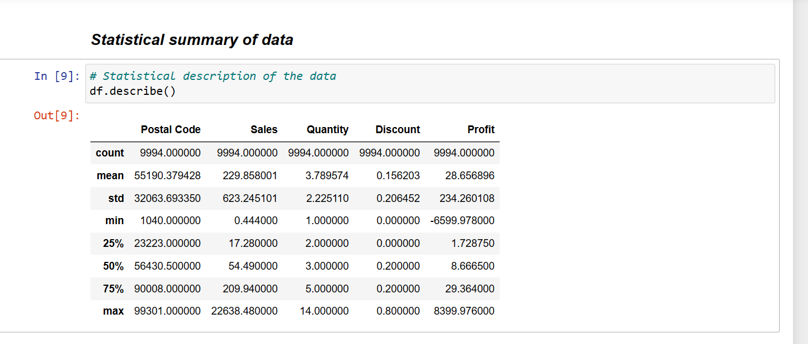

Slide 17
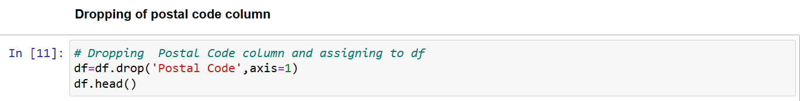
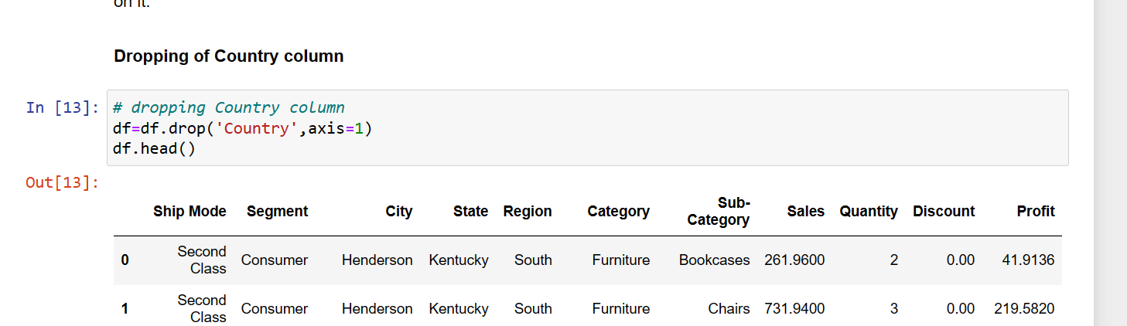
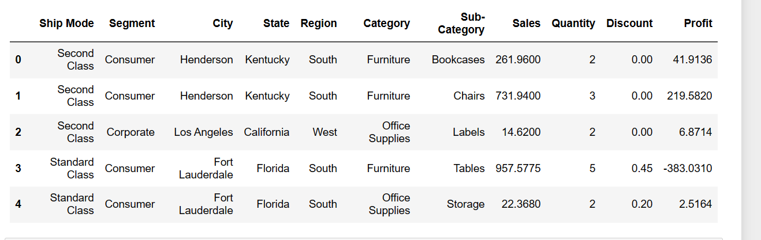
Dropping Unnecessary Columns
'Postal Code' column is nothing so we can drop this column.
The data is for US country only, so we can drop the 'Country' column as we don't need any analysis to be done based on it.

Slide 18
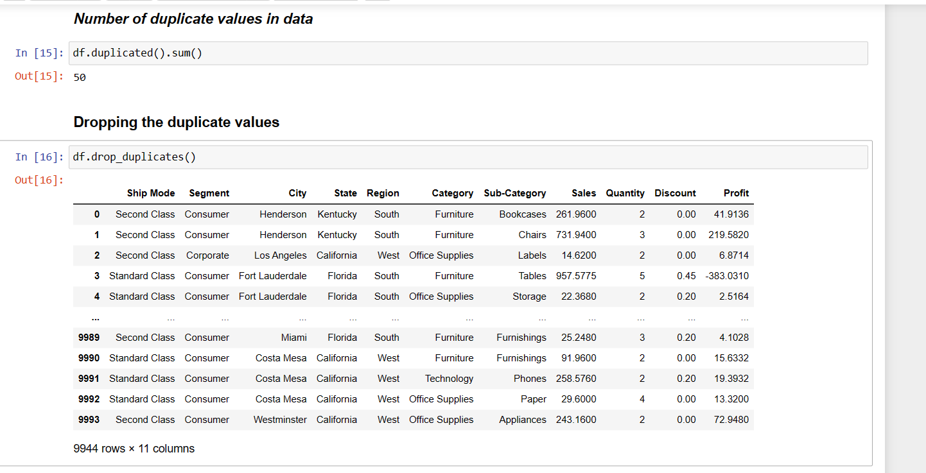

Slide 19
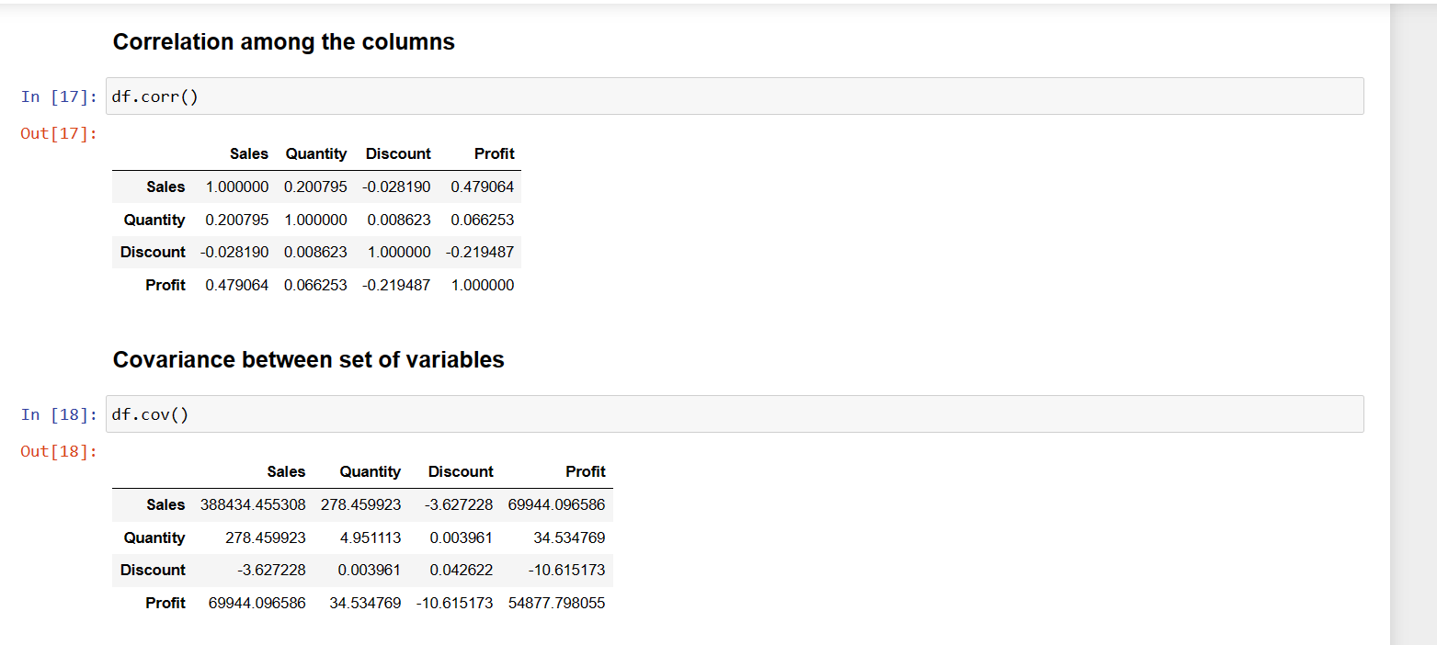

Slide 20
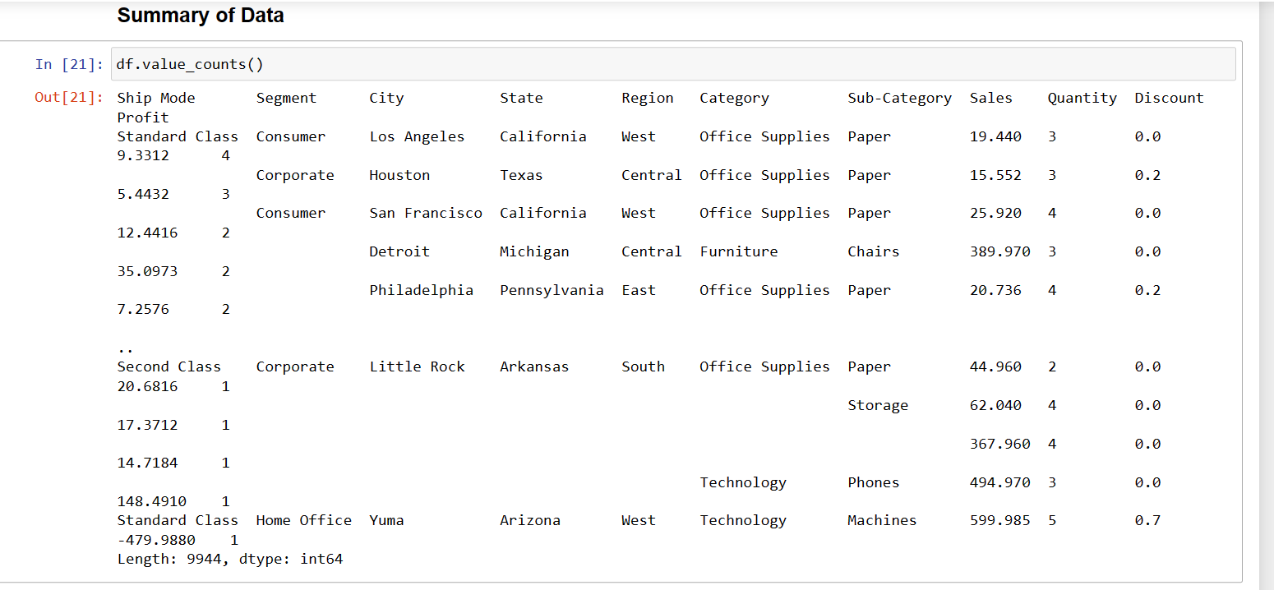

Slide 21
Visualization of Data
We can visualize the data further in 4 different ways
Region level
Segment level
Category & Sub-category level
City & State level

Slide 22
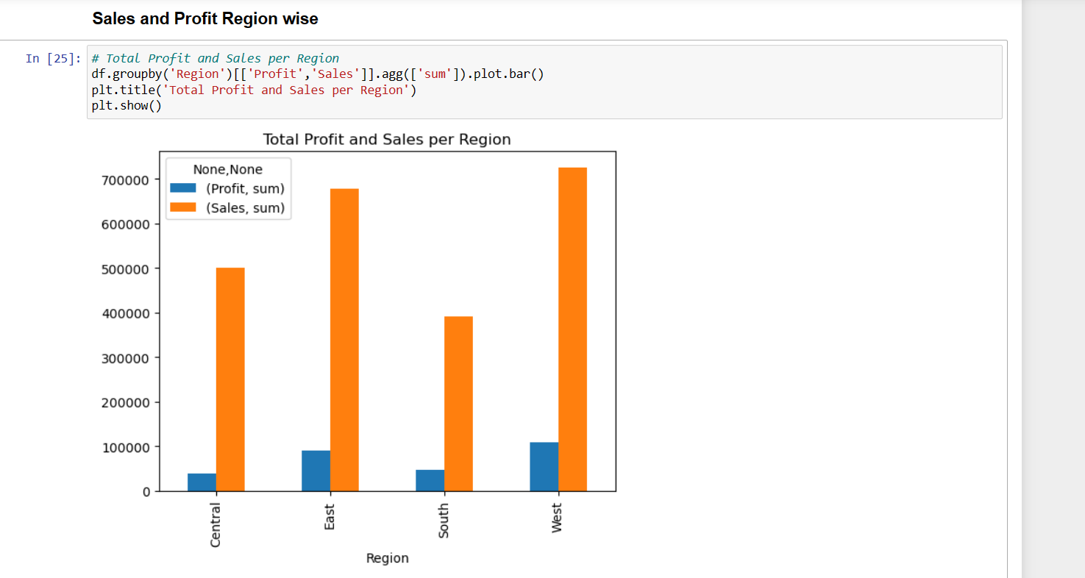

Slide 23
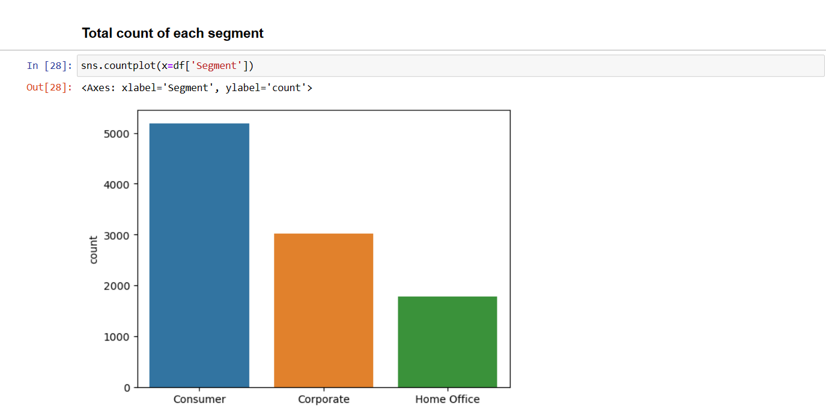

Slide 24
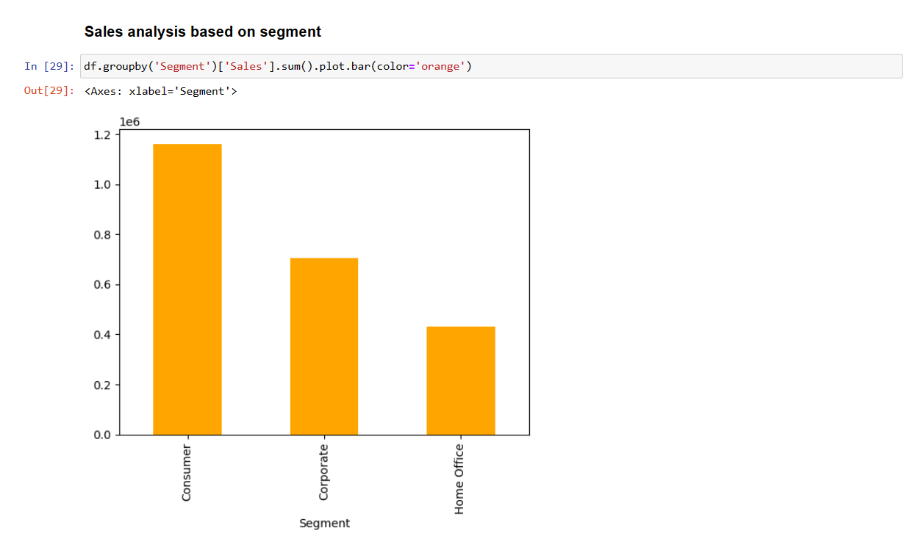
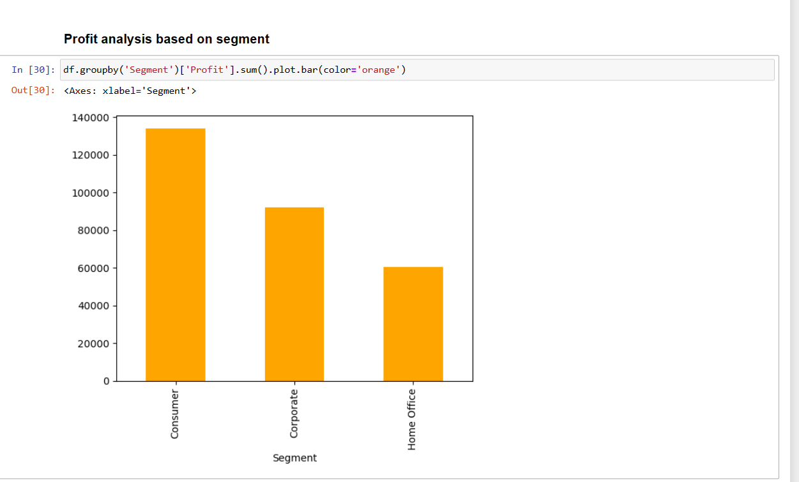

Slide 25
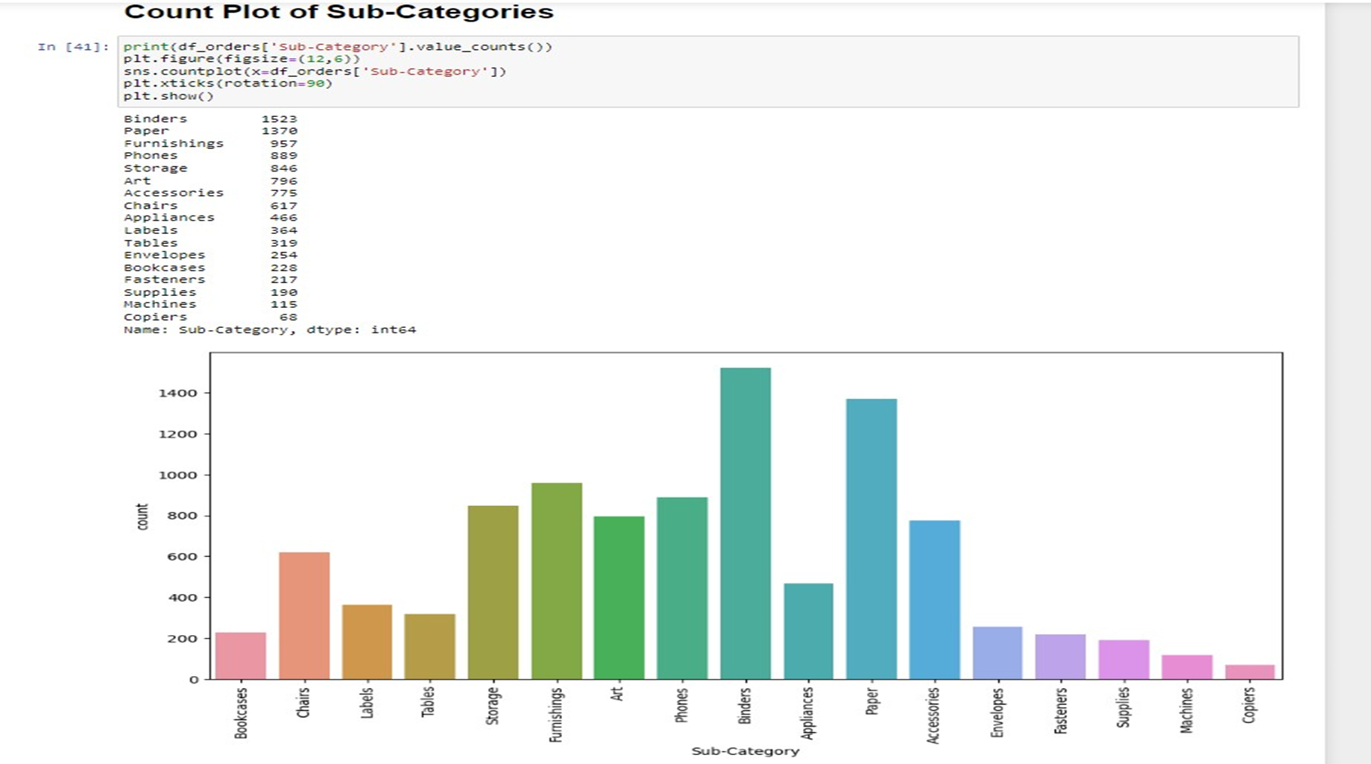

Slide 26
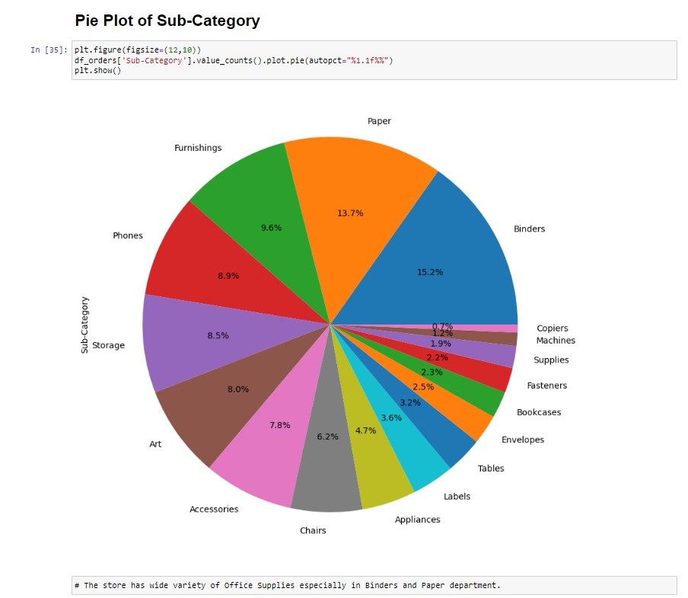

Slide 27
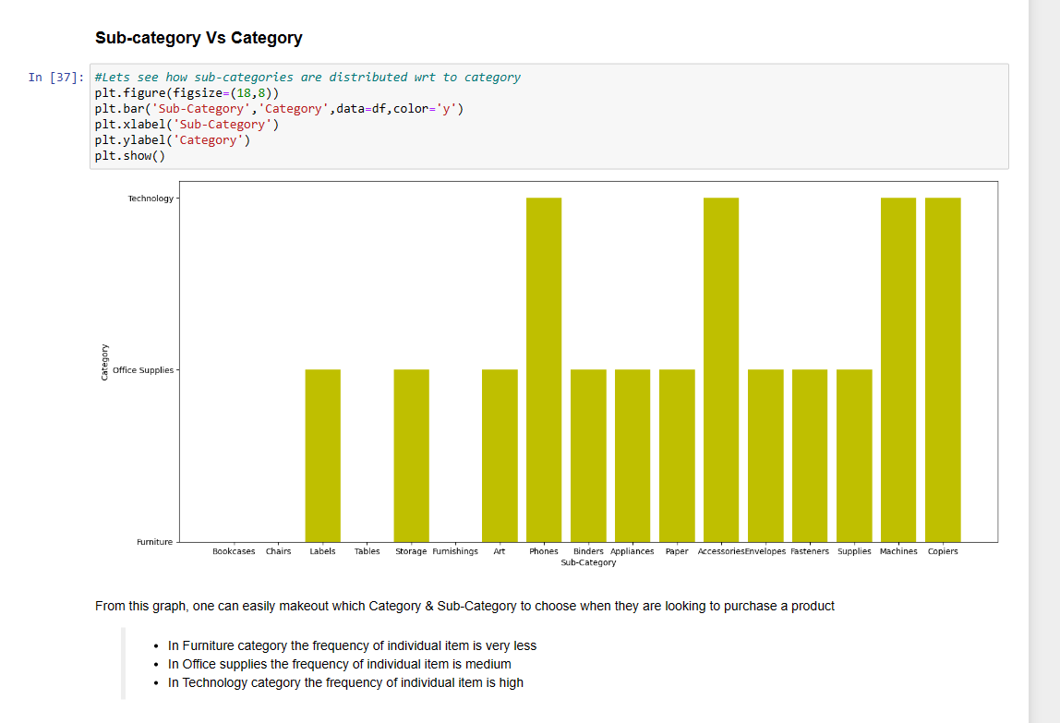

Slide 28
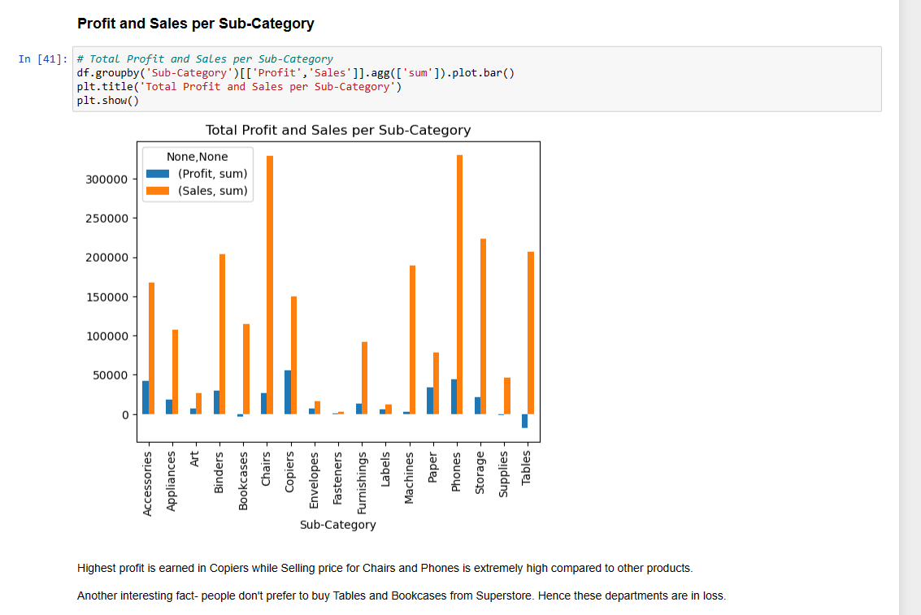

Slide 29
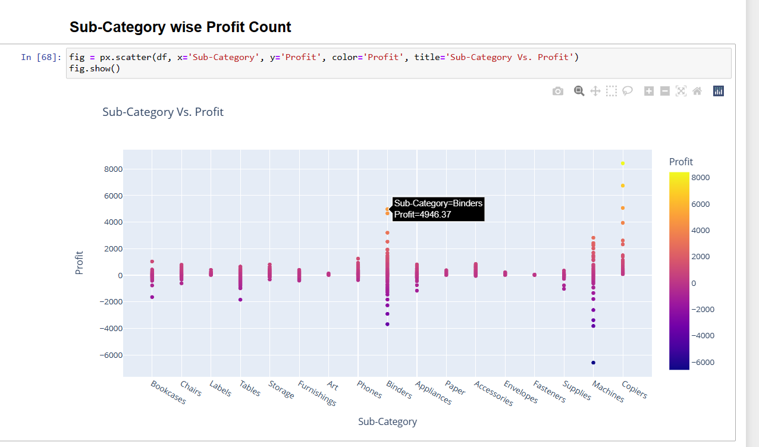

Slide 30
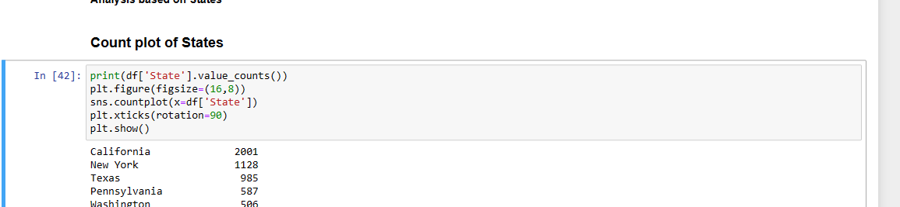
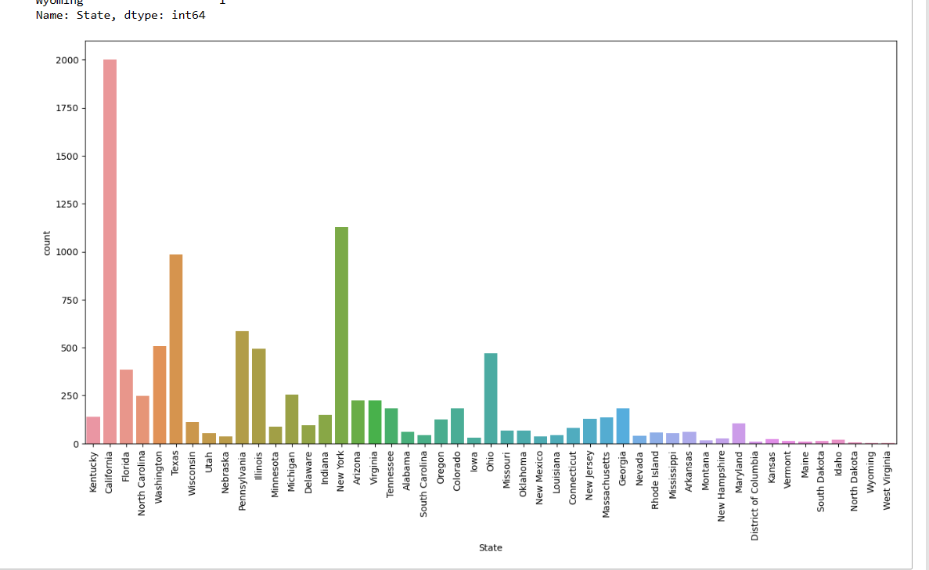

Slide 31
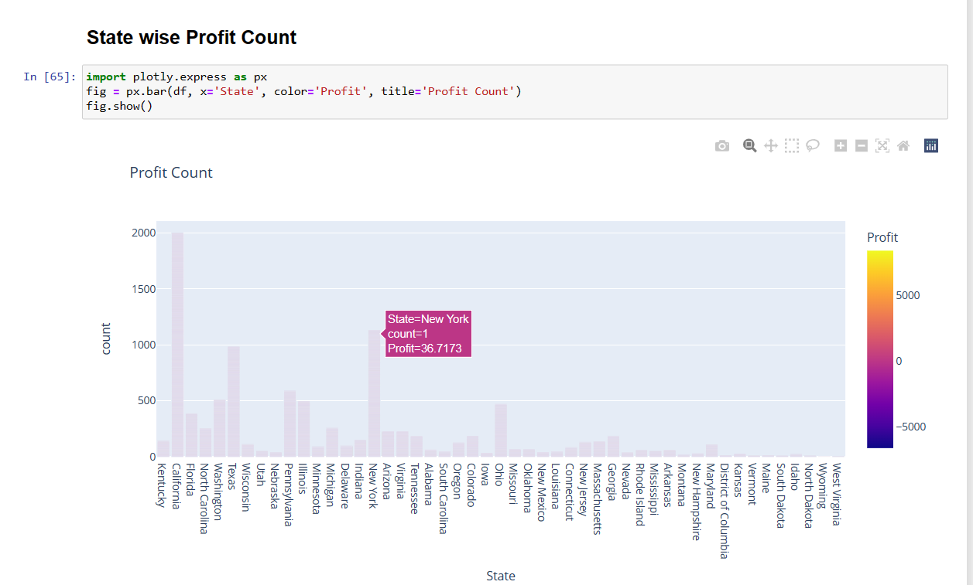

Slide 32
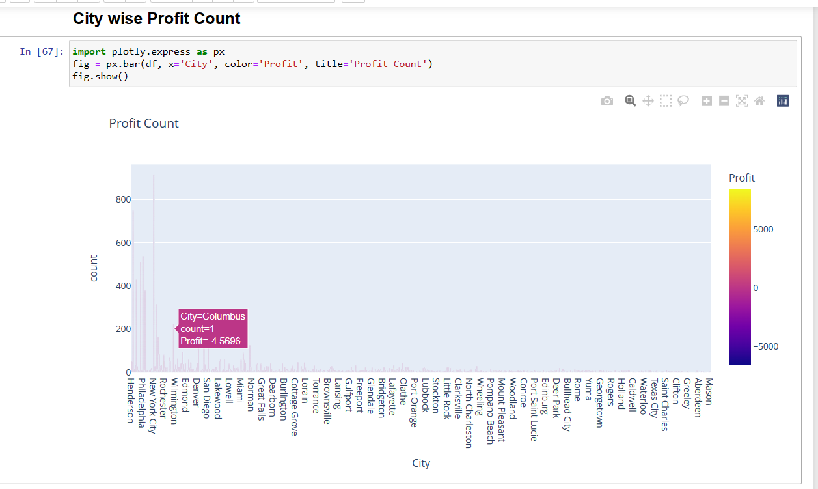

Slide 33
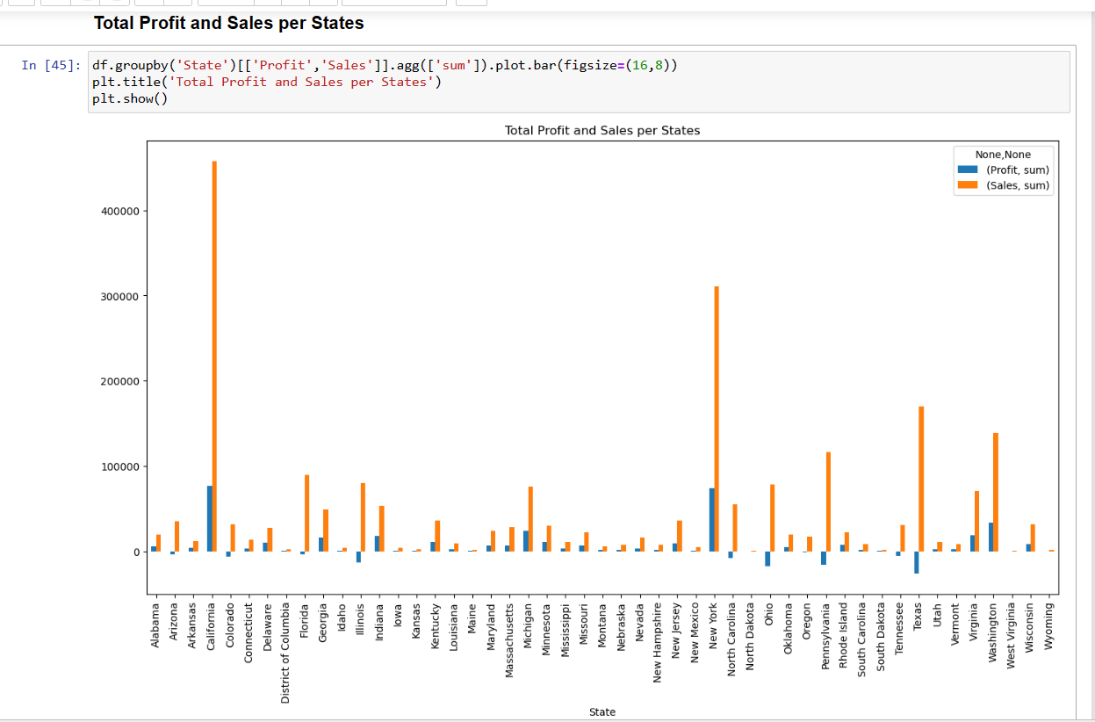

Slide 34
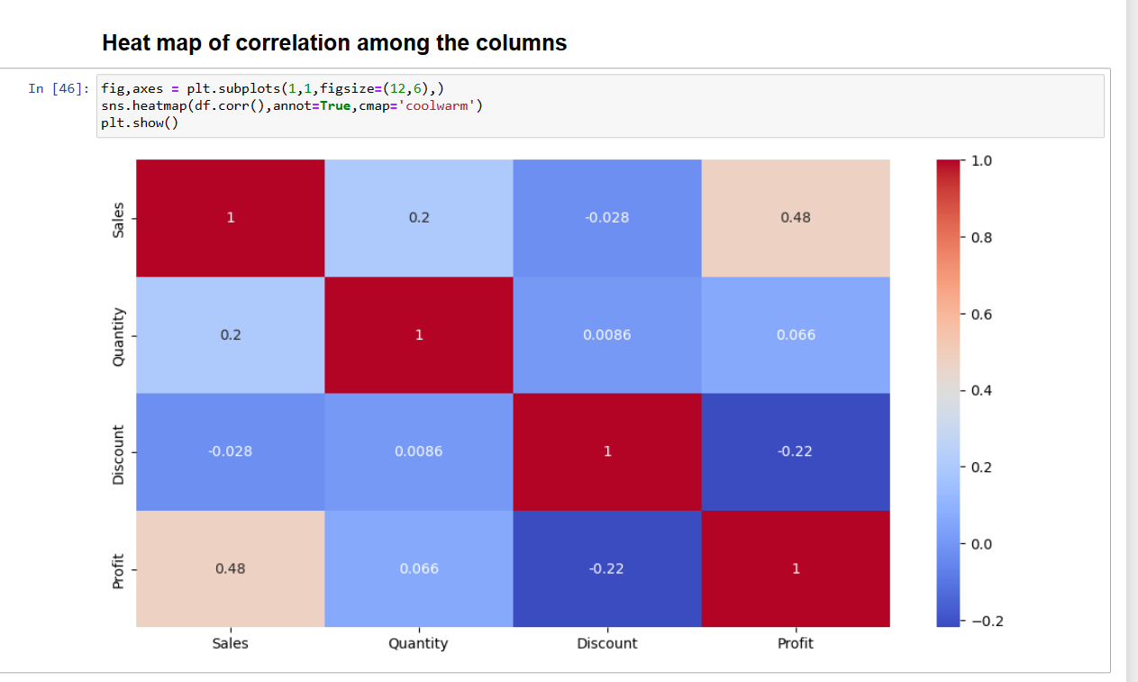

Slide 35
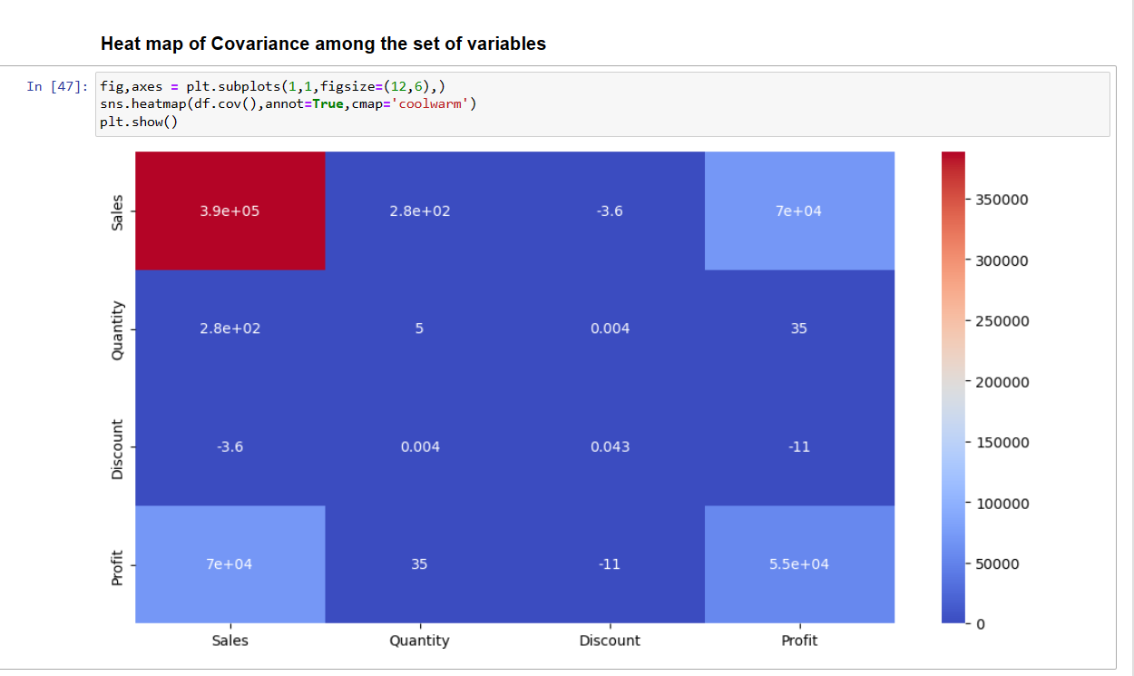

Slide 36
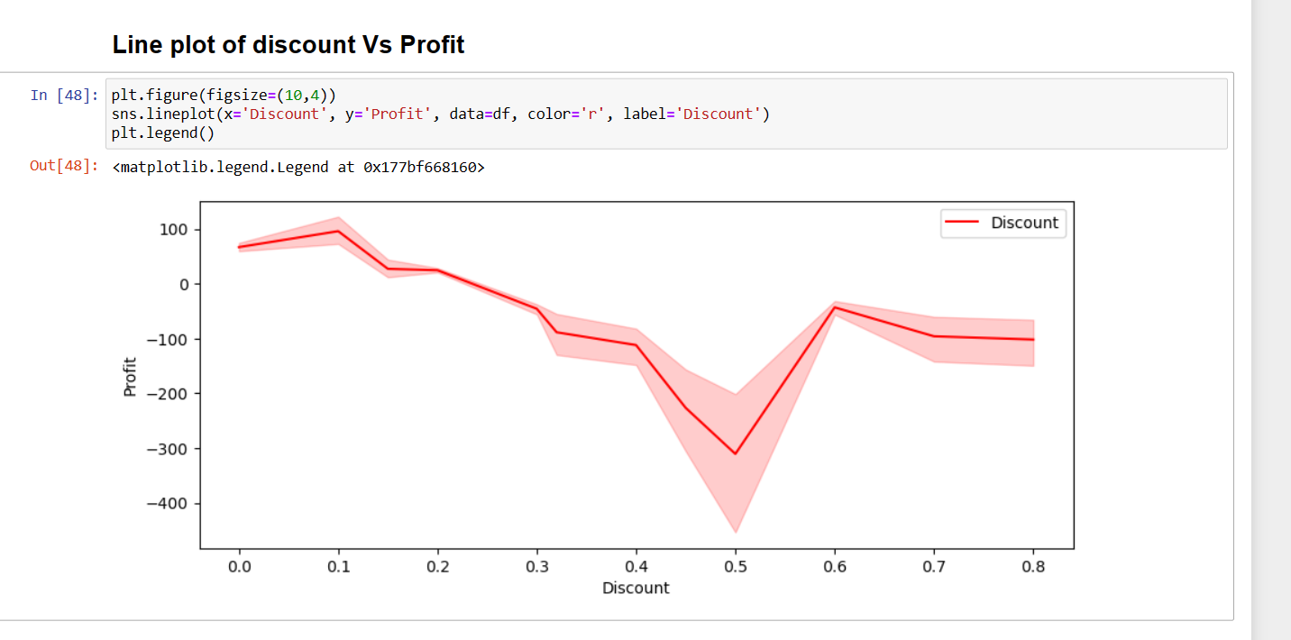

Slide 37
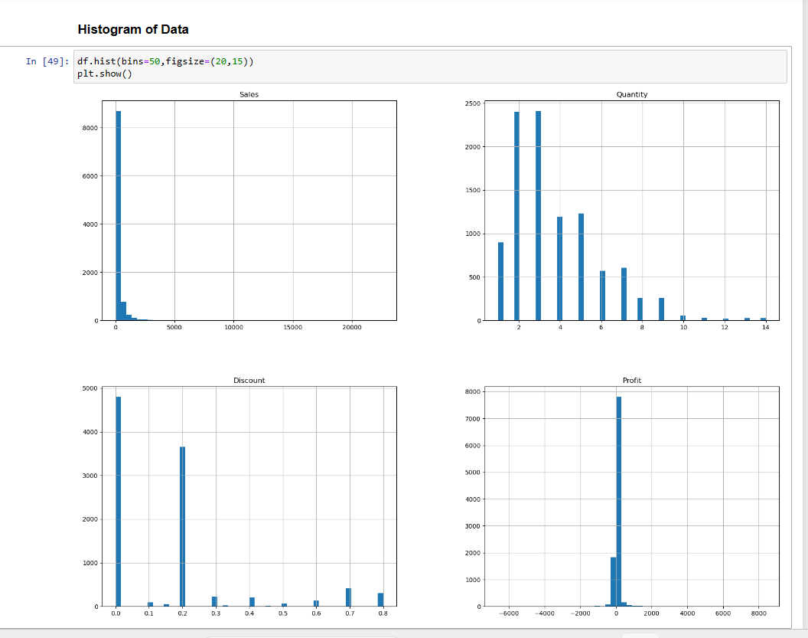

Slide 38
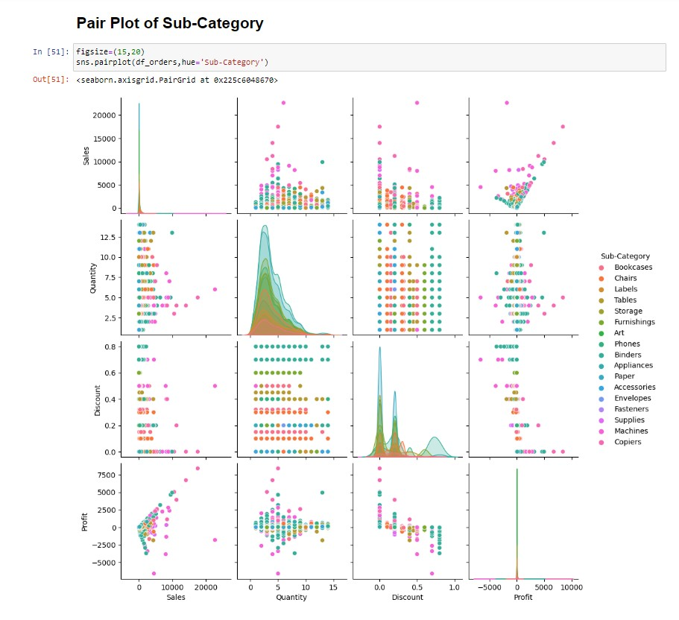

Slide 39
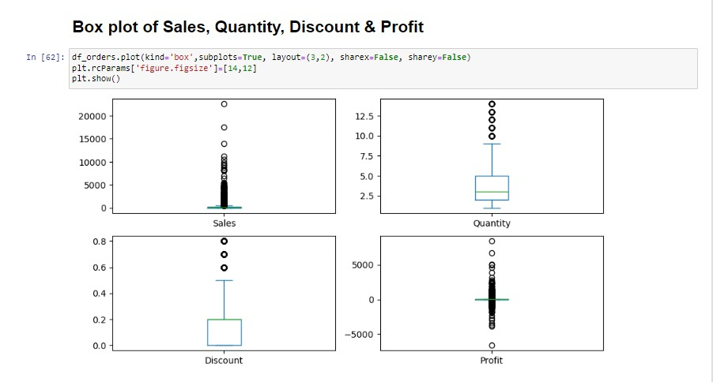

Slide 40
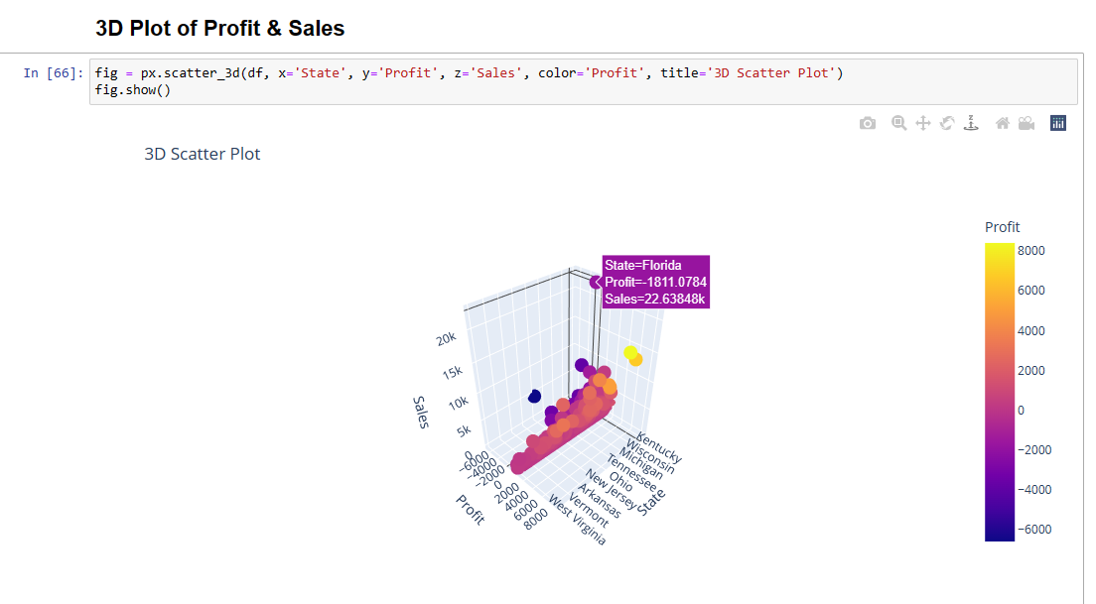

Slide 41
Results
Sales Analysis Results:
- Identified sales trends over time (monthly, quarterly, yearly) and identified peak seasons or periods of high demand.
- Analyzed the performance of different product categories and identified top-selling and underperforming products.
Profitability Analysis Results:
- Calculated profit margins for different products and product categories to identify the most profitable and leas profitable items.
- Analyzed the impact of discounts, shipping costs, or other factors on profitability.
Customer Behavior Analysis Results:
- Analyzed customer purchasing patterns, such as frequency, recency, and monetary value, to understand customer
loyalty and lifetime value.
- Identified factors influencing customer churn and developed strategies for customer retention.
- Explored cross-selling and upselling opportunities based on market basket analysis and product association.
Recommendations and Insights:
- Provided actionable recommendations to improve sales, profitability, and customer satisfaction based on the analysis results.
- Proposed strategies for targeted marketing campaigns, product promotions, or customer retention initiatives.

Slide 42
Conclusion
The analysis of the Superstore dataset has provided valuable insights into sales trends, customer behavior, and operational efficiency. Through exploratory data analysis and advanced modeling techniques, we have identified several significant findings:
•Sales Trends: The analysis revealed seasonal patterns, with peak sales occurring during specific months. Additionally, certain product categories exhibited higher demand and profitability than others, indicating opportunities for strategic focus and optimization.
•Customer Segmentation
•Predictive Insights: These insights enable proactive decision-making and assist in effective resource planning and inventory management.
•Enhanced Profitability
•Improved Decision Making
•Customer Satisfaction and Retention
Moving forward, it is recommended that the Superstore continues to monitor sales performance, customer behavior, and operational metrics. This will allow for ongoing adjustments and improvements based on changing market dynamics and evolving customer preferences.
Overall, the "Analysis of Superstore dataset" project demonstrates the power of data analytics in uncovering insights that drive strategic decision-making, operational efficiency, and ultimately, the success of the Superstore in a competitive retail market.

